Slide 1

Ministry/Organization Name : Indian Space Research Organisation
Category : Software Domain Bucket : Miscellaneous
Team Name : DOT Team Leader Name : Kowsalya S
College Code : 1-3511226476
Problem Code: Size invariant ship detection from SAR Images(NM404)
Description :
The methodology helps in detecting ships at sea using SAR data and estimating size of the detected ship invariant of size.It can be applicable to any resolution SAR data of same band.
* SAR-Synthetic Aperture Radar

Slide 2

Proposed Solution
Ships of invariant size are detected by identifying the threshold using CA-CFAR for the given SAR image.”PIL” is used to process SAR image of any resolution of same band.
The Land-Water discrimination is done using the Morphological filtration which includes Low pass filtering and High pass filtering
Now the Binary image is obtained.Dilation and erosion method is used to accurately find out the difference between land and water.
Now the given dataset is processed by the Neural Networks and Deep Learning and the threshold is estimated based on the given dataset which is used to differentiate Islands and Ships.
Vector image of the identified Ship is obtained and perimeter and surface area of the Ship is evaluated.
Technology Stack and Implementation
TOOLS | ALGORITHM | LIBRARY
CONDA (PYTHON) | CA- CFAR METHOD | OPENCV ,PIL , NUMPY,MATPLOTLIB
* CA-CFAR - Cell Average Constant False Alarm Rate
PIL - Python Imaging Library
SAR - Synthetic Aperture Radar

Slide 3
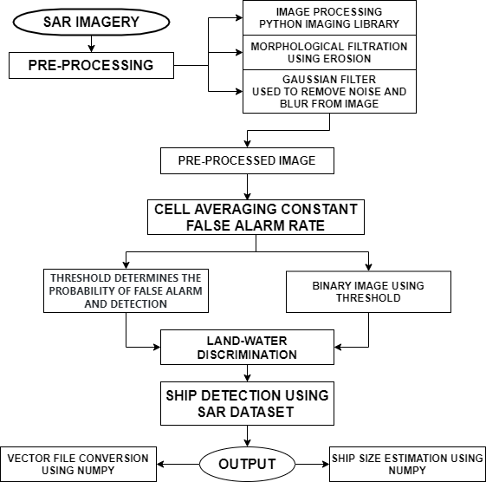
USECASE:
The proposed methodology is a crucial application for Maritime Security and Defence.
SAR imagery uses radio waves to image the Earth’s Surface,the wavelength’s which the instruments use are not affected by the Meteorological conditions.
Intruder ships can be detected using given SAR dataset which helps in enhancement of protection measures.
* SAR-Synthetic Aperture Radar

Slide 4
SHOW STOPPERS
Speckle effect and effect of Topography decreases the detection rate.
Inadequate information from Dataset.
Suitable only for stationary and slow moving target coherence among collected signals.

